Slide 1
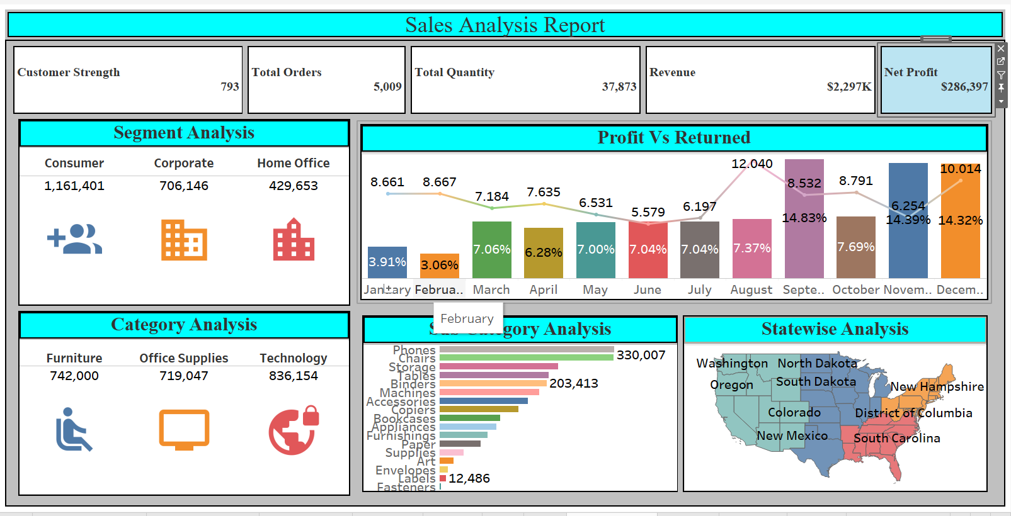
Superstore Sales Analysis Report using Tableau

Slide 2
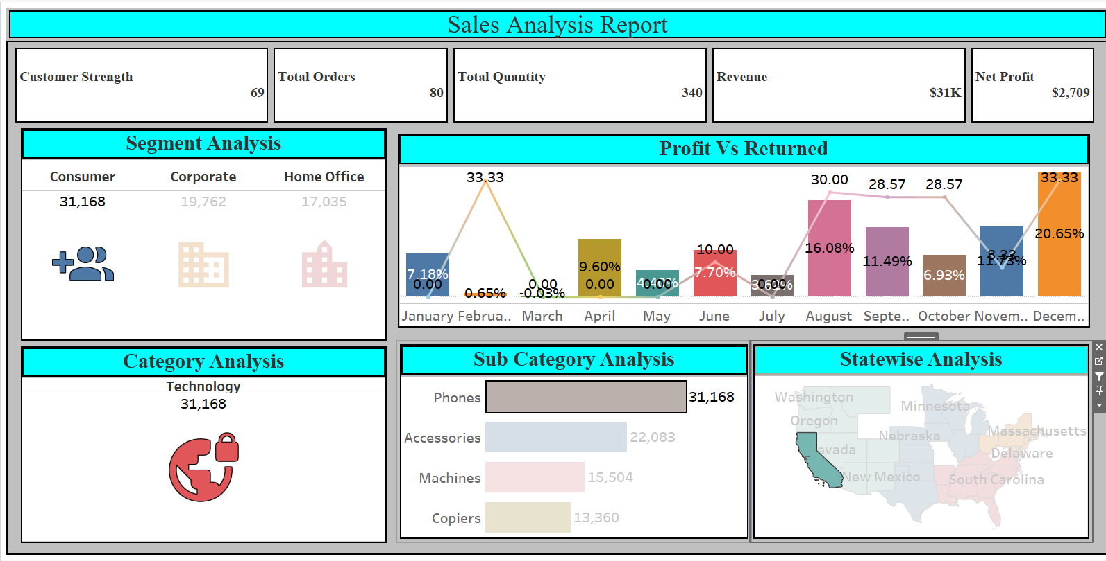
Strategy : Consumer--> Technology →Phone →California (State)
Suggestion
December is the best month for Profit
Warning
February onwards profit is declining March is difficult so don’t keep more inventory in stock from January onwards

Slide 3
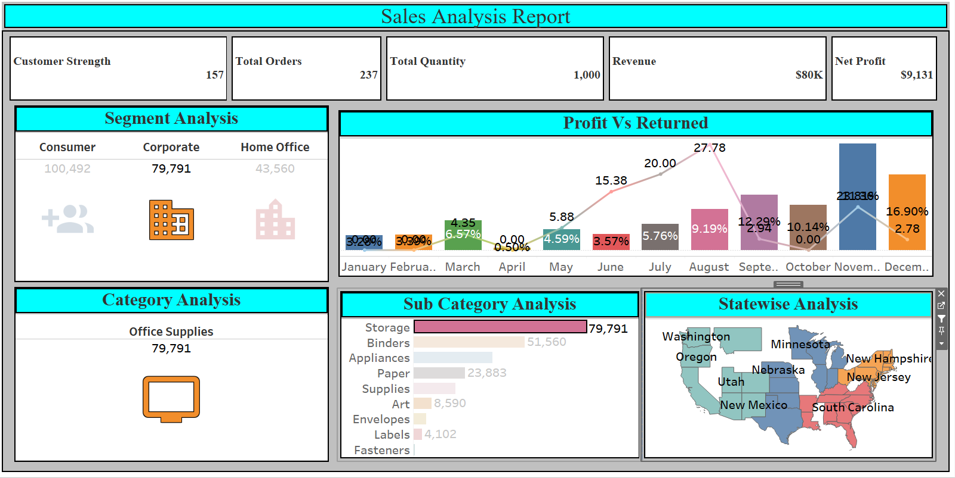
Corporate --> Office supplies → Storage → California (state)
Suggestion
December is the best month for Profits 15k & 7.5k
Warning
Jan is 0 Profit & feb shows small upcline in business With a zero returned rate

Slide 4
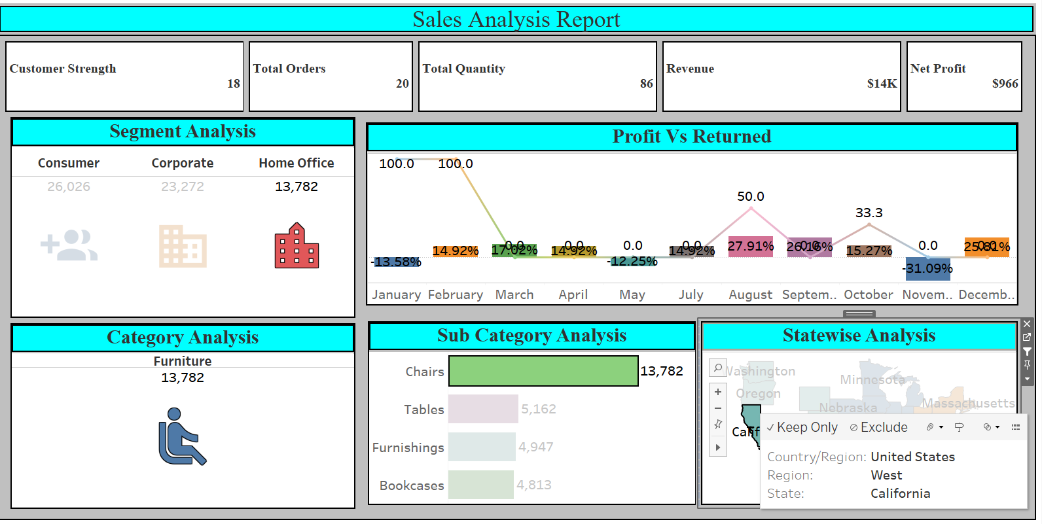
Home Office--> Furniture→ Chair→ California (state)
Suggestion
August is the best month for
Warning
April onwards profit is declining Mayis difficult so don’t keep more inventory in stock.

Slide 5
Thank You
Diksha Bhushan Waghmare
Data science Intern
Team Ayush

